Slide 1


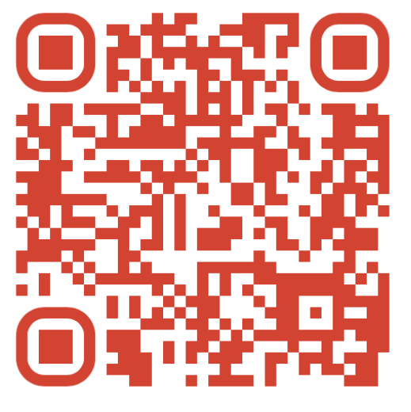


2025 Boys & Girls Cross Country
Summer Off-Season Conditioning Begins June 2nd
QR code has locations, times and days
Bring water bottle, running shoes, and good attitude
Open to all current and Future Dorados!
Scan the QR Code to see the XC website and all things CDO XC
Scan Me
Questions?
Contact Coach Marek doradosxc@gmail.com

